Slide 1
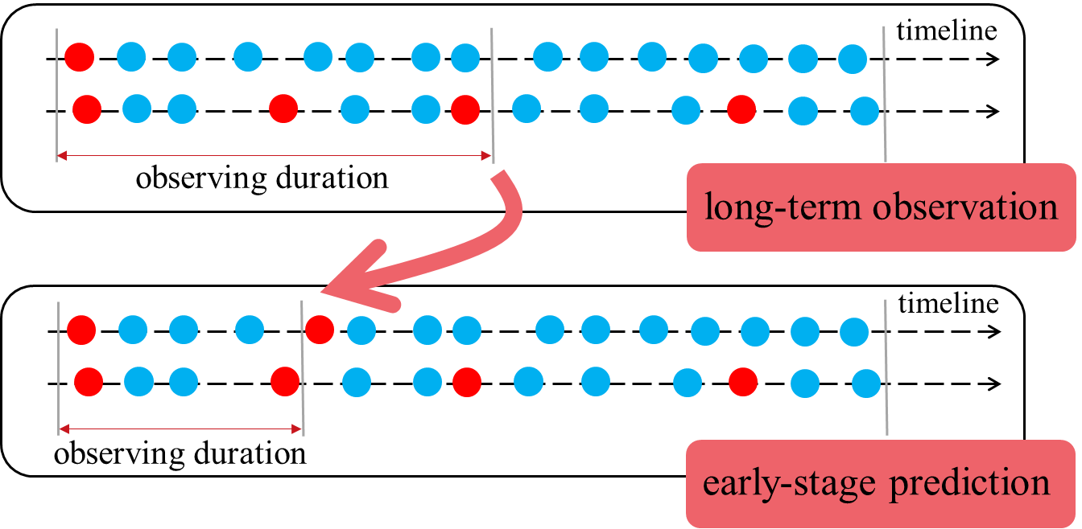
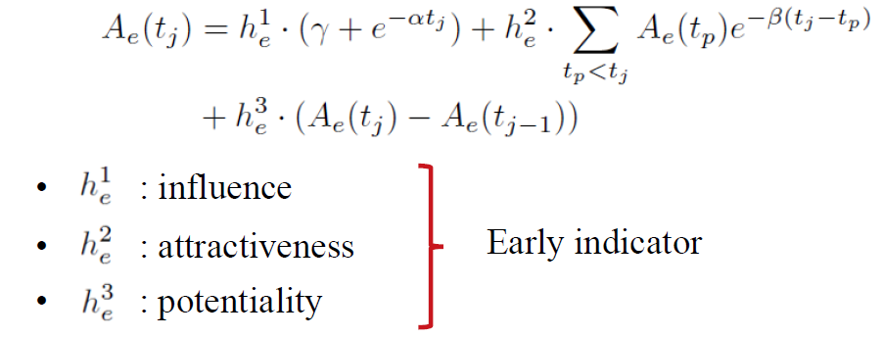
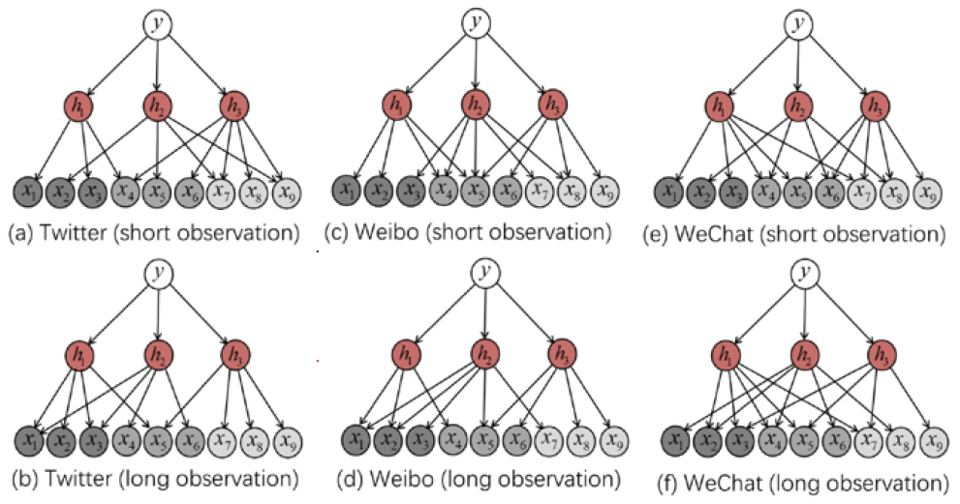
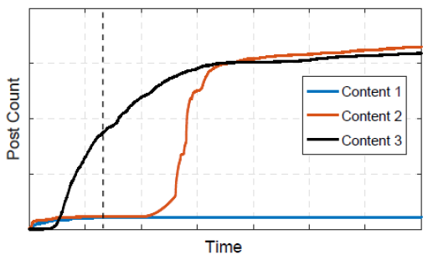
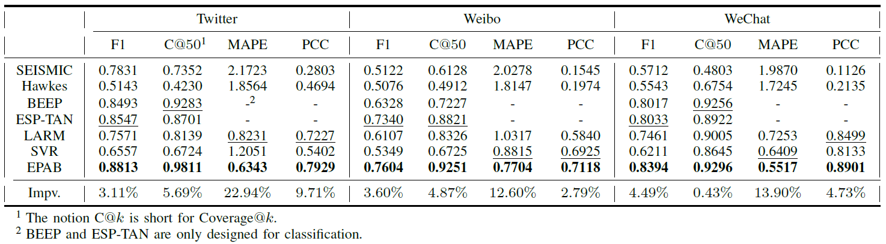
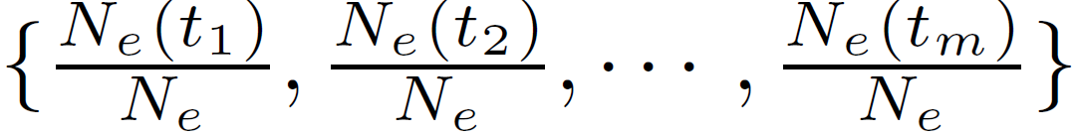
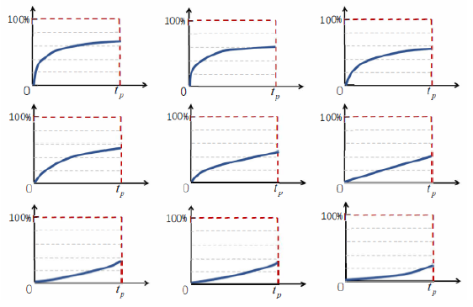
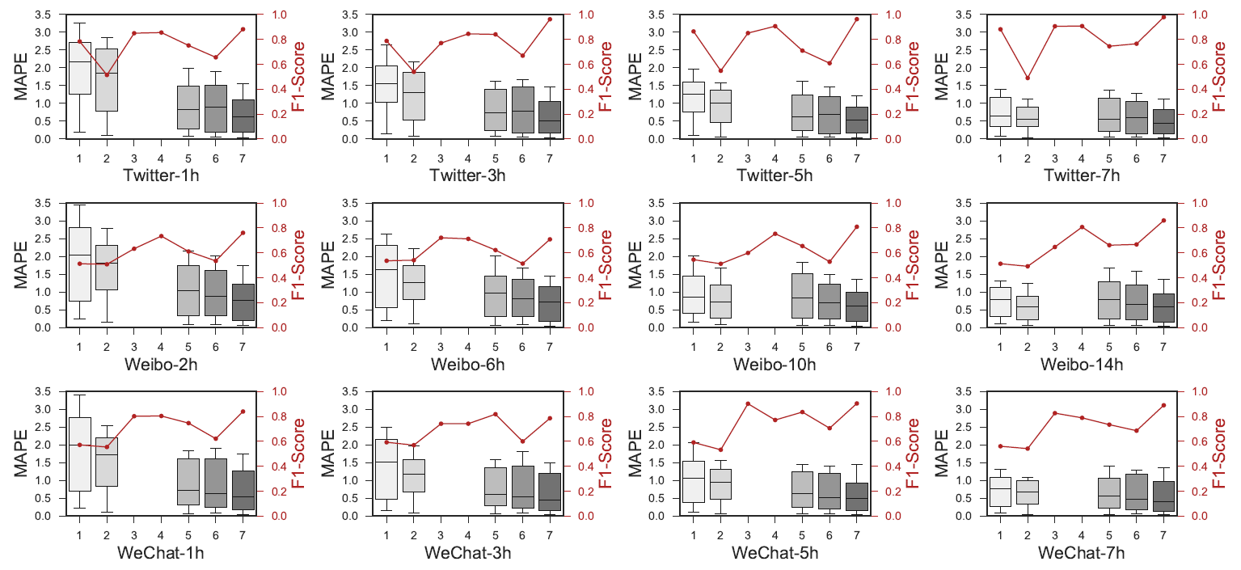
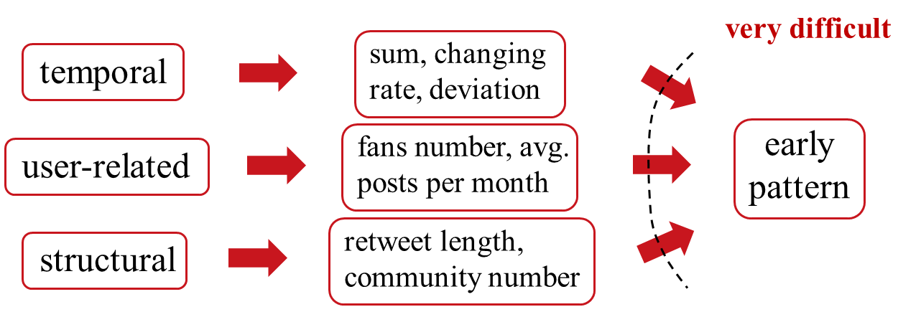
Early Pattern Aware Bayesian Model for Social Content Popularity Prediction
1
1
1
2
1
Qitian Wu , Chaoqi Yang , Xiaofeng Gao , Peng He , Guihai Chen
Department of Computer Science and Engineering, Shanghai Jiao Tong University, China
Tencent, Shenzhen, China
1
2
Motivation & Background
Methodologies (Cont.)
• Define an evolving function to characterize the evolution trend:
• Adopt Bayesian network to model the relationship among early features, early indicators and early patterns
With tweets in observing duration, one would like to know how many tweets will be posted in the end.
• rumor monitoring
• personalized recommendation
• anomaly detection
• targeted advertisement
Early-stage prediction challenges: observed time series could behave similarly at early stage but evolve in a different way in the future.
Methodologies
Experiments
Early Pattern
Early Indicator
Bayesian Model
• 3 real-world datasets: Twitter, Weibo, WeChat
• 1h observation for Twitter and WeChat, 2h for Weibo
Clustering
Evolving Function
Parameter and Structure Learning
• Comparative methods: Hawkes Process, SEISMIC, BEEP, ESP-TAN, LARM, Support Vector Regression
• Early pattern: count series normalized on popularity
Use K-means algorithm to cluster contents into groups with similar early patterns
• Extract temporal, user-related, structural features from data

